Slide 1


Minstrel - Music Library
Under Guidance of -
Prof. Abhishek Sharma
Saladi V S S Siva Hemanth Kumar Hemanthsaladi2004@gmail.com
WIPRO NGA - MERN - FY26 - Cohort 3

Slide 2
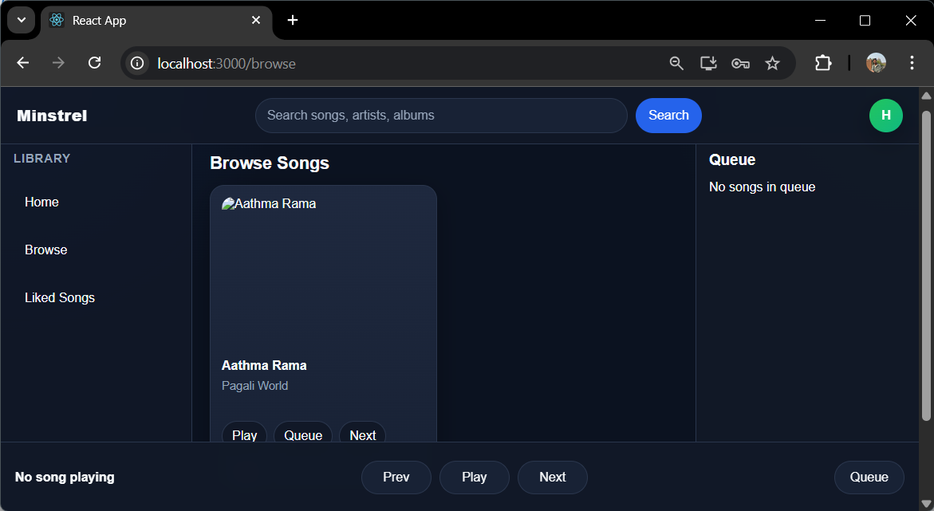
Key Functionalities for Users
Login and Registration
Songs List
Search Functionality
Users can easily register and log into the application, ensuring personalized access to their music library and playlists while maintaining a secure environment for their data.
A comprehensive list of songs is available for users to browse, with detailed information about each track, including artist names, albums, and playtime.
Users can effortlessly search for songs by artist, album, or director, making it simple to locate their favorite tracks quickly.
2

Slide 3
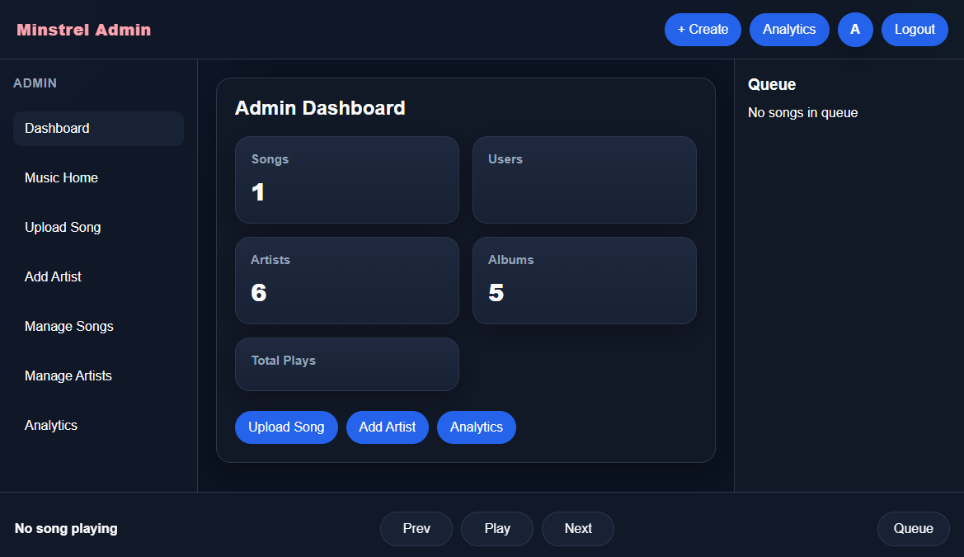
Admin Capabilities
add new songs to the music library
delete songs from the library
add new artists
manage the complete song database
control song visibility for users
view statistics / dashboard data
upload multiple songs
Admin has protected access using JWT authentication
3

Slide 4
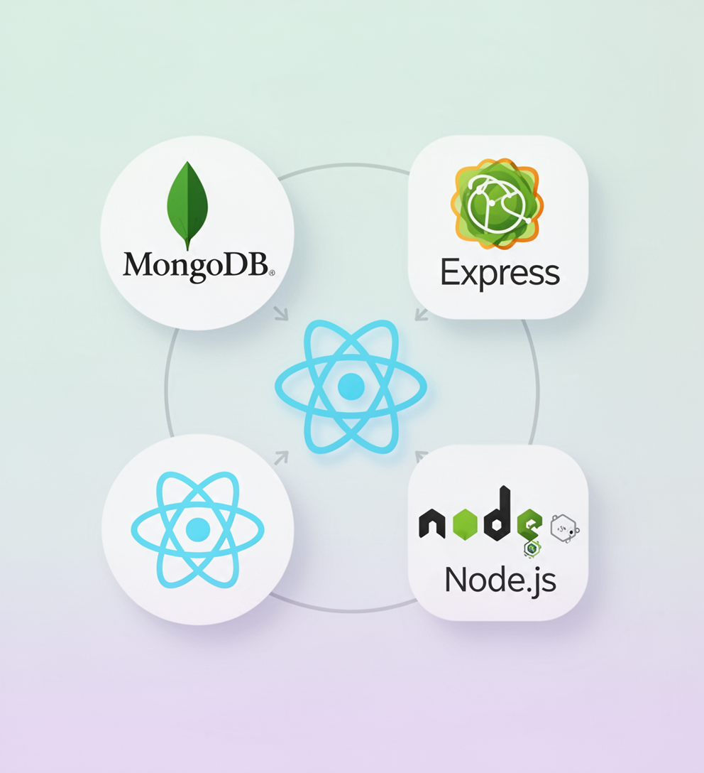
Technologies Used in the Project
The Minstrel Music Library utilizes the MERN stack, comprising
MongoDB
Express
React
Node.js
for seamless development, enabling efficient data management, user interface creation, and robust backend functionality for a dynamic application.

Slide 5
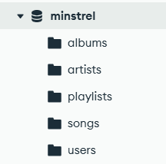
Database Schema Overview
The database schema consists of essential collections
Album
Artist
Playlist
Song
User
This structured organization enables efficient data management and supports the application's core functionalities.

Slide 6
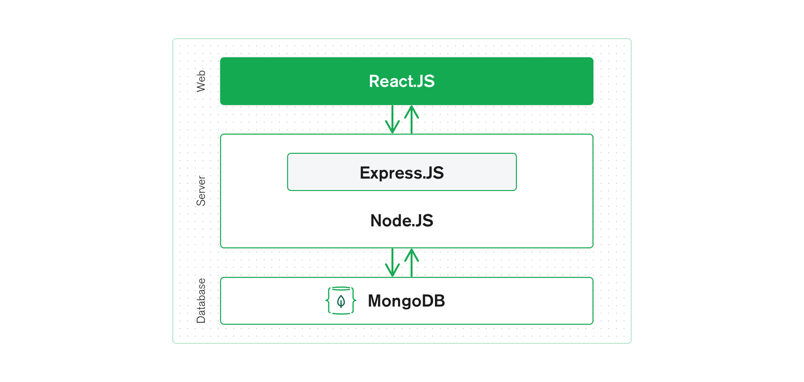
System Architecture and Flow
React → Frontend UI, user interacts with app
Node.js → Runtime environment for backend
Express.js → Handles API requests and routing
MongoDB → Stores and retrieves data
React sends request to backend
Node runs the backend server
Express handles API route
MongoDB stores / fetches data
Response goes back to React

Slide 7
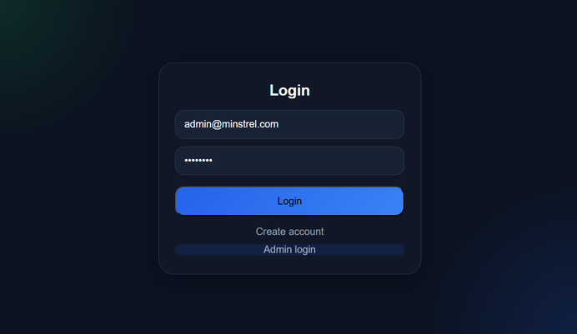
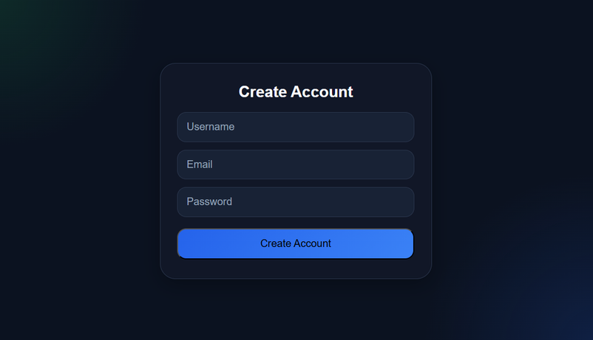
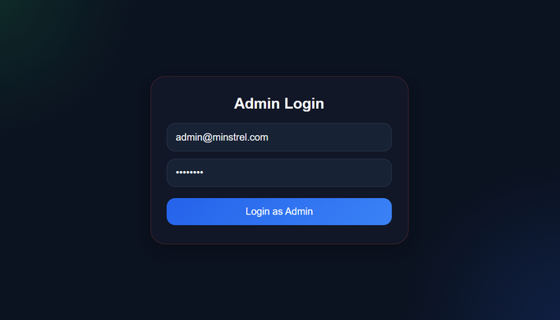
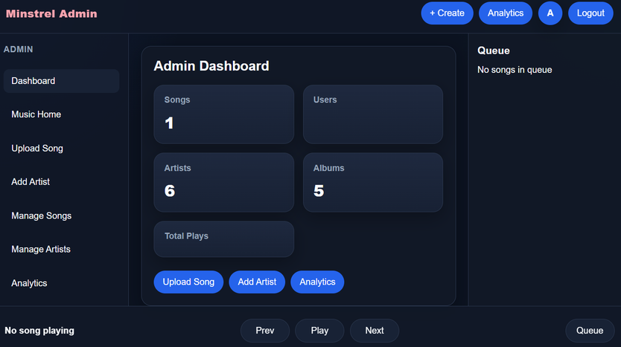
Authentication: User and Admin Login Interfaces
User Login
User Signup
Simple interface for user authentication process.
Streamlined form for new user registration.
Admin Login
Admin Dashboard
Secure access for administrative functions.
Comprehensive controls for managing the application.

Slide 8
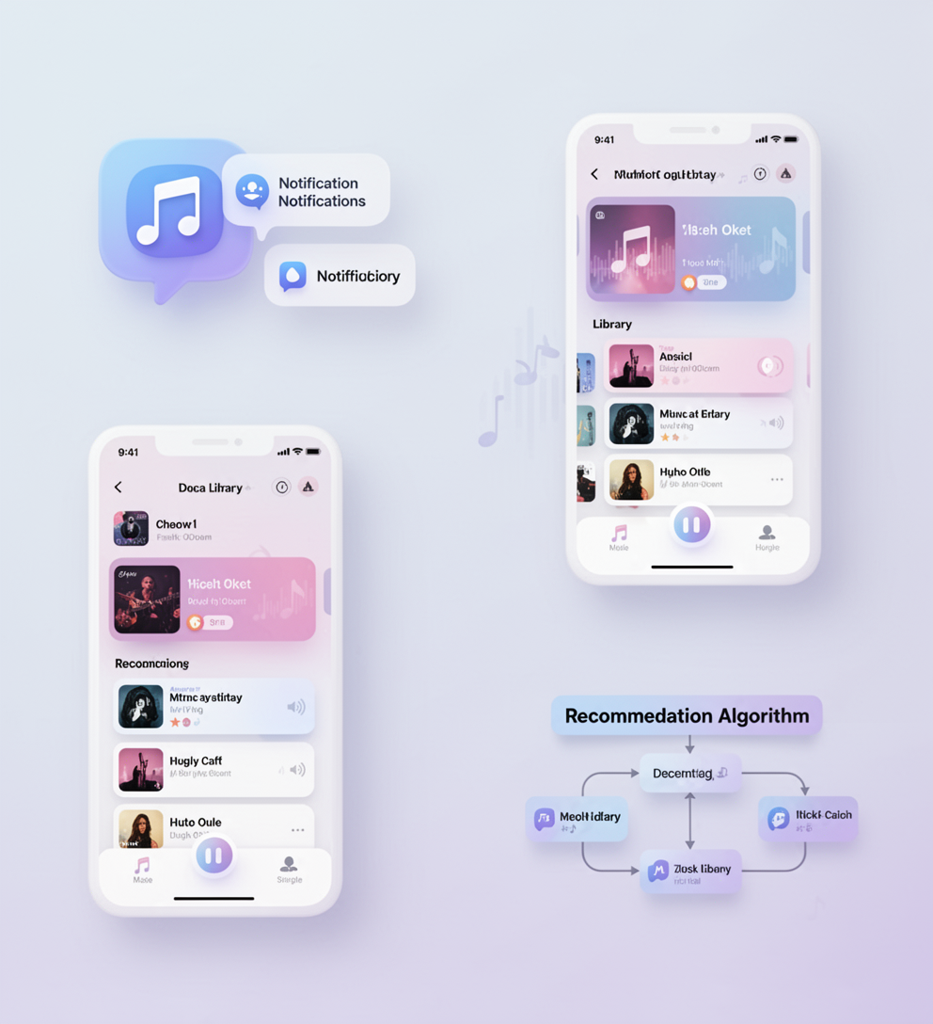
Future Enhancements for Minstrel
Push notifications
Song recommendation system
Cloud-based audio storage
Dark/light theme preference saved in database
Mobile-responsive enhanced version (with Layout Change)
Enhanced Admin Dashboard

Slide 9
Thank You

